Slide 1
Root Finding 3: Sundry Other Methods
AMSC/CMSC 460
Dr. Christopher Moakler

Slide 2
Summary of last time
Newton’s Method is one of the most frequently used root finding algorithms.
It has quadratic convergence for simple roots.
If it has degenerate roots it’s only linearly convergent.
It can be modified to retain the quadratic convergence.
Sometimes the derivative required for Newton’s Method is unavailable or costly to evaluate so we instead approximate it with a Secant Method.
The Secant Method is superlinearly convergent.

Slide 3
Summary of last time Contd
When there exists a degenerate root, Newton’s Method will not be able to find a root within machine epsilon.
This is not a failing of the Newton Method alone, no method will be able to approach machine epsilon for certain functions.
The issue is inherent to the function itself.
This is the first time we have seen the issue of ill-conditioning.
Every sort of problem we might want to analyze has an associated condition number, a quantification of how sensitive the problem is to slight perturbations.

Slide 4
Reguli Falsi
The Method of False Position, also known as Reguli Falsi, is an ancient method of solving equations of a single variable.
The Rhind Papyrus makes use of this.
For example, problem 26 can be written as $x+ \frac{x}{4}=1$5.
We can start with an initial guess of say $x_{0}=4$.
$4+ \frac{4}{4}=5$.
This is too small by a factor of 3, so let’s triple our initial guess, $x_{1}=x_{0}=12.$
$12+ \frac{12}{4}=15$.
The correct solution is thus, $x=12$.

Slide 5
Reguli Falsi Contd
That was an example of Simple False Position.
Simple false position is effectively guessing and checking and was used before the advent of algebra and equations as we know them
This form is found in Babylonian cuneiform tablets and on ancient Egyptian papyri.
It’s SUPER old.
Double False Position is used to solve equations of the form,
$mx+d=0$
This algorithm began to be used in late antiquity to solve these sorts of problems
This is the version that will be useful to us!

Slide 6
Double False Position
You will almost always hear Double False position referred to as simply the Method of False Position or Reguli Falsi.
It is very similar to the method of Bisection.
Instead of using the midpoint, we instead use a “Secant-like” approximation of the new root.
Given an interval $\left[a,b\right]$, we construct a secant line between the point $(a,f\left(a\right))$ and $\left(b,f\left(b\right)\right).$
The point-slope form of this line is,
$y −f\left(b\right)= \frac{f\left(b\right)−f\left(a\right)}{b−a}(x−b)$

Slide 7
Double False Position Contd
The point-slope form of this line is,
$y −f\left(b\right)= \frac{f\left(b\right)−f\left(a\right)}{b−a}(x−b)$
Plugging in $x=c$ such that $f\left(c\right)=y$ yields,
$−f\left(b\right)= \frac{f\left(b\right)−f\left(a\right)}{b−a}\left(c−b\right),$
$f\left(b\right)+\frac{f\left(b\right)−f\left(a\right)}{b−a}(c−b)=0.$
Solving this for $c$ gives us,
$c=b−f\left(b\right)\frac{b−a}{f\left(b\right)−f\left(a\right)}$
$c=\frac{af\left(b\right)−bf(a)}{f\left(b\right)−f\left(a\right)}$
We can use this as an update step in an iterative process.

Slide 8
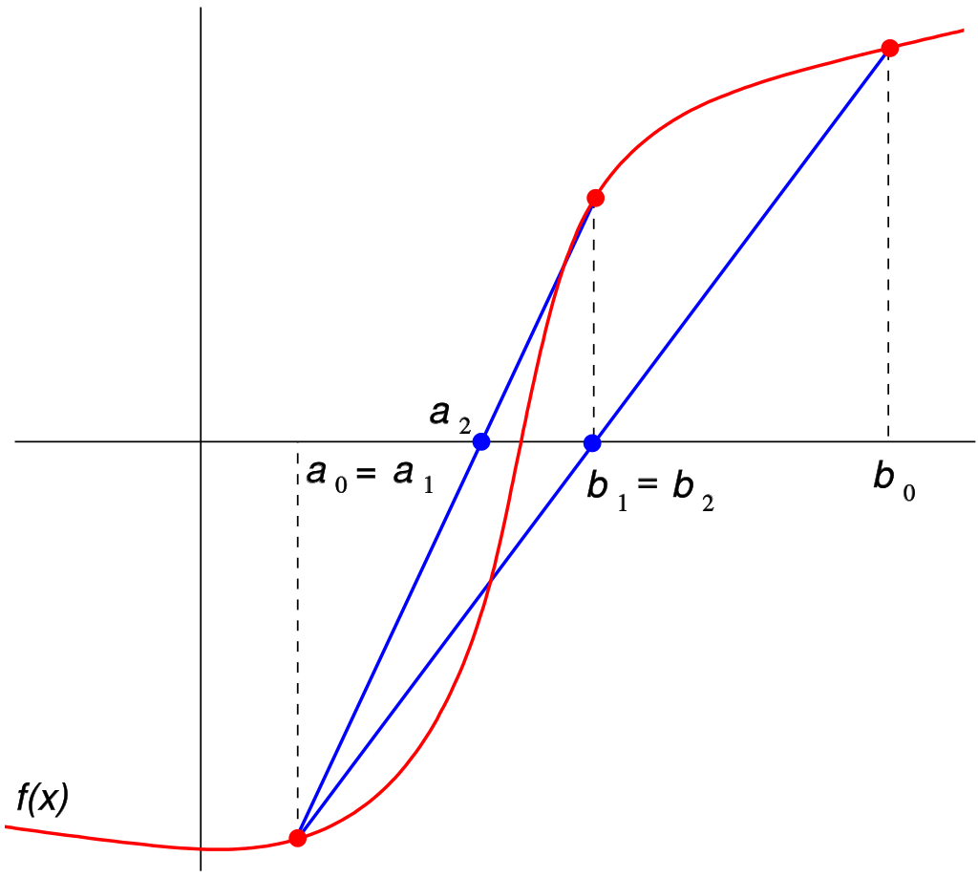
Double False Position Graphically
https://commons.wikimedia.org/wiki/File:False_position_method.svg

Slide 9
Double False Position Algorithm
$a_{0}=rand$
$b_{0}=rand$
for i = 1:nstepmax
$c=\frac{af\left(b\right)−bf(a)}{f\left(b\right)−f\left(a\right)}$
if $f\left(c\right)=0$
return
end
if $f\left(a\right)f\left(c\right)<0$
$b=c$
else
a=c
end
end

Slide 10
Double False Position pros and cons
Reguli Falsi combines aspects of both bisection, the bracketing of the root, and the secant method, a more intelligent choice of a new bracket.
Bisection guarantees a halving of the interval at every step, Reguli Falsi does not.
It can sometimes have very slow convergence.
Reguli falsi is guaranteed to converge while the Secant Method is not.
There are also modifications of Reguli Falsi with faster convergence.

Slide 11
The Illinois Algorithm
Sometimes the convergence of Reguli Falsi is very slow.
We can fix this by modifying the update step.
If $f\left(c_{k}\right)$ and $f(c_{k−1})$ have the same sign we modify our end points.
If we go left twice, we use,
$c=\frac{af\left(b\right)−\frac{bf(a)}{2}}{f\left(b\right)−\frac{f(a)}{2}}$
If we go right twice, we use,
$c=\frac{\frac{af\left(b\right)}{2}−bf(a)}{\frac{f(b)}{2}−f\left(a\right)}$
This factor of $\frac{1}{2}$ guarantees a superlinear convergence.
You can sometimes pick a better rescaling to get even better convergence.

Slide 12
The Illinois Algorithm Graphically
Hoffman

Slide 13
The Illinois Algorithm Example

Slide 14
Muller’s Method
The Secant Method approximates the objective function with a linear function.
Another approach would be to approximate the objective function with a parabola.
This approach requires 3 initial points: $x_{0},x_{1},and x_{2}$.
We approximate the function with,
$g\left(x\right)=a{\left(x−x_{i}\right)}^{2}+b\left(x−x_{i}\right)+c$
We than require that the parabola goes through three points:
$g\left(x_{i}\right)=f\left(x_{i}\right)=a{\left(x−x_{i}\right)}^{2}+b\left(x−x_{i}\right)+c$
$g\left(x_{i−1}\right)=f\left(x_{i−1}\right)=a{\left(x−x_{i−1}\right)}^{2}+b\left(x−x_{i−1}\right)+c$
$g\left(x_{i−2}\right)=f\left(x_{i−2}\right)=a{\left(x−x_{i−2}\right)}^{2}+b\left(x−x_{i−2}\right)+c$

Slide 15
Muller’s Method Contd
Solving for $a,b, and c$ yields,
$a= \frac{\left(x_{i−2}−x_{i}\right)[f\left(x_{i−1}\right)−f\left(x_{i}\right)]−\left(x_{i−1}−x_{i}\right)[f\left(x_{i−2}\right)−f\left(x_{i}\right)]}{(x_{i−2}−x_{i})(x_{i−1}−x_{i})(x_{i−2}−x_{i−1})}$
$b= \frac{{\left(x_{i−2}−x_{i}\right)}^{2}[f\left(x_{i−1}\right)−f\left(x_{i}\right)]−{\left(x_{i−1}−x_{i−2}\right)}^{2}[f\left(x_{i−2}\right)−f\left(x_{i}\right)]}{(x_{i−2}−x_{i})(x_{i−1}−x_{i})(x_{i−2}−x_{i−1})}$
$c_{i}=f\left(x_{i}\right)$
Solving, $g\left(x_{i+1}\right)=a{\left(x_{i+1}−x_{i}\right)}^{2}+b\left(x_{i+1}−x_{i}\right)+c$, for $(x_{i+1}−x_{i})$ using the quadratic formula yields
$\left(x_{i+1}−x_{i}\right)= \frac{−b ±\sqrt{b^{2}−4ac}}{2a}$
We typically want to use the “rationalized” quadratic formula since it has better computational characteristics.
$\left(x_{i+1}−x_{i}\right)= \frac{−2c}{b ±\sqrt{b^{2}−4ac}}$

Slide 16
Muller’s Method Contd
We typically want to use the “rationalized” quadratic formula since it has better computational characteristics.
$\left(x_{i+1}−x_{i}\right)= \frac{−2c}{b ±\sqrt{b^{2}−4ac}}$
We choose the sign in the denominator to be the same as the sign of $b$ so that $x_{i+1}$ is close to $x_{i}$
This method has faster convergence than the Secant Method but slower than that of Newton’s Method.
Typically, the Secant Method is preferred because it’s easier to implement.

Slide 17
How can Muller’s Method fail?
If the three guesses have the same y value, the method fails.
If the three points fall on the same line, the method fails.
How can we fix these problems?

Slide 18
Inverse Quadratic Interpolation
Instead of approximating the objective function with a parabola of the form $y=g(x)$ we can instead use a parabola of the form $x=g(y)$.
This solves the problem of choosing which x-intercept to pick since there is now only one intersection.
Again the parabola goes through three points $\left(x_{i−2},f\left(x_{i−2}\right)\right),\left(x_{i−1},f\left(x_{i−1}\right)\right), and (x_{i},f\left(x_{i}\right))$
The function looks like,
$g\left(y\right)=x_{i−2}\frac{(y−f\left(x_{i−1}\right))(y−f\left(x_{i}\right))}{(f\left(x_{i−2}\right)−f(x_{i−1}))(f\left(x_{i−2}\right)−f\left(x_{i}\right))}+b\frac{(y−f\left(x_{i−2}\right))(y−f\left(x_{i}\right))}{(f\left(x_{i−1}\right)−f(x_{i−2}))(f\left(x_{i−1}\right)−f\left(x_{i}\right))}+c\frac{(y−f\left(x_{i−2}\right))(y−f\left(x_{i−1}\right))}{(f\left(x_{i}\right)−f(x_{i−2}))(f\left(x_{i}\right)−f\left(x_{i−1}\right))}$

Slide 19
Inverse Quadratic Interpolation Contd
Plugging in for $y=0$ gives us,
$x_{i+1}=x_{i}−\frac{r\left(r−q\right)\left(x_{i}−x_{i−1}\right)+\left(1−r\right)s\left(x_{i}−x_{i−2}\right)}{\left(q−1\right)\left(r−1\right)\left(s−1\right)},$
where $q={f(x_{i−2})}/{f(x_{i−1})}, r= {f(x_{i})}/{f(x_{i−1})}, and s= {f(x_{i})}/{f(x_{i−2})}$
This can be used as an update step in an iterative algorithm.
One can also use this updated guess to replace the guess with the worst backward error.
This method has faster convergence than the Secant Method.
This method is combined with the Secant and Bisection methods to make Brent’s Method.

Slide 20
Brent’s Method
Due to Richard Brent.
He built on the method of Theodorus Dekker.
This is sometimes called the Brent-Dekker method.
In short, Inverse Quadratic Interpolation is attempted.
If both the backward error improves and the interval is at least halved, we accept the update.
If not, we instead use the Bisection Method to update our guess.
This ensures that the interval is always at least halved.

Slide 21
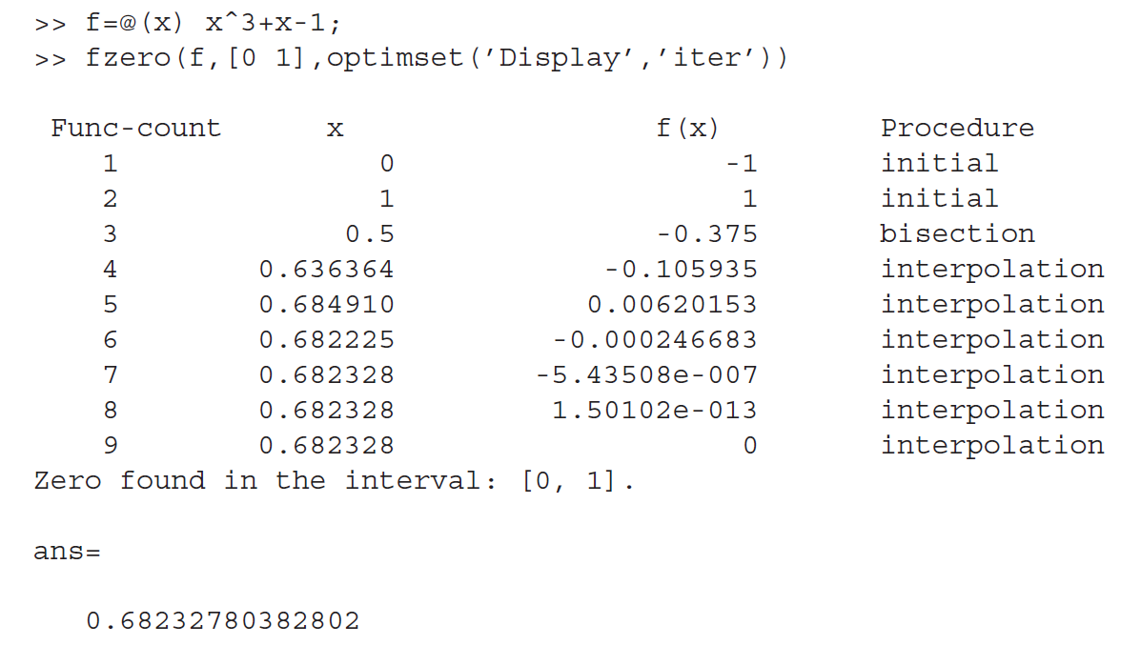
Matlab’s Implementation of Brent’s Method
Matlab’s “fzero” function implements Brent’s Method.
If no interval is provided, Matlab attempts to find one that brackets a zero.
Matlab stops iterating if the forward error is within $2ε_{mach}$ or the backward error achieves machine zero.
This dual stopping condition can be used on your homework,
Sauer

Slide 22
Polynomial Interpolation
Muller’s Method and Inverse Quadratic Interpolation are both examples of polynomial interpolation.
Approximating functions with polynomials is ubiquitous in science, engineering, and data analysis in general.
We will return to this idea later in the semester.

Slide 23
Complex Roots
All of the methods we’ve discussed thus far have been applied to find exclusively real roots.
Which, if any, of these methods can be extended to find complex roots?
Bisection Method?
Not easily.
Newton’s Method?
Yes, if we provide a complex initial guess.
Secant Method?
Yes, if we provide a complex initial guess.
Muller’s Method?
Yes, no change necessary.

Slide 24
Polynomial Root Finding
The methods we have described can easily be used to find the roots of polynomials.
For certain polynomials, we can analytically determine the roots of the equation.
I.e., linear, quadratic, cubic, and quartic.
No closed algebraic solution exists for the general quintic function.
This extends to all polynomials of higher order as well.
Descartes’ Rule of signs can be used to determine the number and sign of the solutions.
Polynomials, especially those of higher order, can be sensitive to the values of coefficients
They can be ill-conditioned.

Slide 25
Polynomial Deflation
If we want to find all of the roots of a polynomial, we make use of “polynomial deflation”
Recall that an $m^{th}$ order polynomial can be rewritten as,
$\left(x−r_{1}\right)\left(x−r_{2}\right)…(x−r_{m})$.
Knowing this, when we find one root of a polynomial, we can “deflate” the full polynomial.
For example, if we found $r_{1}$ in the example polynomial, we now only have to find the roots of,
$\left(x−r_{2}\right)…(x−r_{m})$.
We can do this by dividing out the $\left(x−r_{1}\right)$ term.
This makes it easier to find the roots of the successively deflated polynomials.
However, since polynomials can be very sensitive to the coefficients, this procedure can introduce large errors.

Slide 26
General issues of root finding algorithms
There are many things that can make root finding problematic.
If we don’t have a good initial guess, we can spend a long time far away from the root.
There may exist degenerate roots that we are not aware of a priori.
The roots we are interested in may be very close together but distinct.
We may converge to the “wrong” root.
There may exist complex roots that we don’t know about before hand.
If some of our methods approach an inflection point, we can be sent very far away from our root.
We may have issues with ill-conditioning.

Slide 27
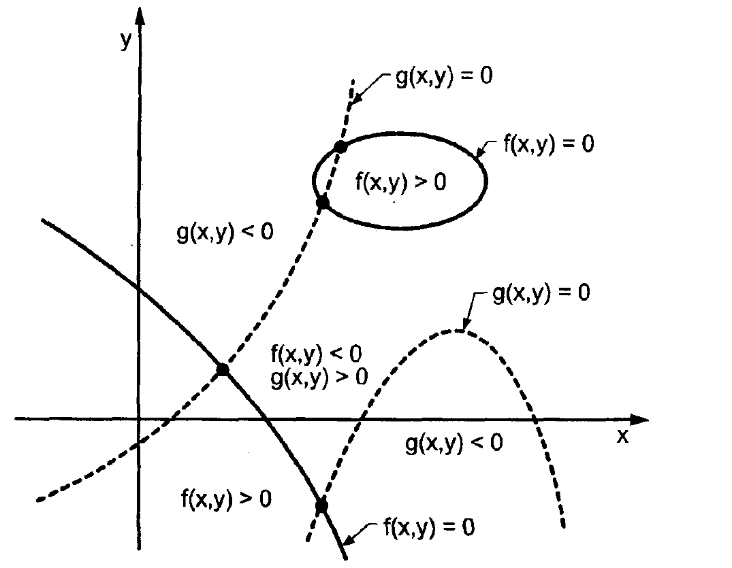
Systems of non-linear equations
We are sometimes interested in finding the roots of two non-linear equations,
$f\left(x,y\right)=0$
$g\left(x,y\right)=0$
Bisection and FPI are not really extendable
to this sort of problem.
We can, however, modify Newton’s Method.
Hoffman

Slide 28
Newton’s Method for systems of non-linear equations
We write the first order taylor series of the two functions,
$f\left(x^{∗},y^{∗}\right)=f\left(x_{i},y_{i}\right)+f_{x}{\left.​\right|}_{{(x}_{i},y_{i})}\left(x^{∗}−x_{i}\right)+f_{y}{\left.​\right|}_{{(x}_{i},y_{i})}\left(y^{∗}−y_{i}\right)=0$
$g\left(x^{∗},y^{∗}\right)=g\left(x_{i},y_{i}\right)+g_{x}{\left.​\right|}_{{(x}_{i},y_{i})}\left(x^{∗}−x_{i}\right)+g_{y}{\left.​\right|}_{{(x}_{i},y_{i})}\left(y^{∗}−y_{i}\right)=0$
We can rearrange this as,
$f_{x}\left(x_{i},y_{i}\right)\left(x^{∗}−x_{i}\right)$+ $f_{y}{\left.​\right|}_{{(x}_{i},y_{i})}\left(y^{∗}−y_{i}\right)=−f(x_{i},y_{i})$
$g_{x}\left(x_{i},y_{i}\right)\left(x^{∗}−x_{i}\right)$+ $g_{y}{\left.​\right|}_{{(x}_{i},y_{i})}\left(y^{∗}−y_{i}\right)=−g(x_{i},y_{i})$
Our update step is,
$x_{i+1}=x_{i}+\left(x^{∗}−x_{i}\right)$
$y_{i+1}=y_{i}+(y^{∗}−y_{i})$
We can solve the middle two equations for the difference terms and update our guess in an iterative method.

Slide 29
Issues and Extensions of Newton’s Method
Newton’s method can be extended to larger systems of non-linear equations.
Evaluating the partial derivatives at every step can become quite costly.
If we do not have analytic derivatives, we can instead approximate the derivatives with the difference quotient.
This isn’t always great.

Slide 30
Another approach to systems of non-linear equations
We can also create a new function, $F(x)$, by combining the different functions.
$F\left(x\right)=f_{1}^{2}+f_{2}^{2}+f_{3}^{2}+…f_{n}^{2}$
This new function has a global minimum when all of the constituent functions are zero.
We can use multidimensional minimizations techniques to find the global minimum of this new function.
This is also the solution of the original system of equations.

Slide 31
Summary Part 1
Reguli Falsi combines the best aspects of the Bisection Method and the Secant Method
Guaranteed convergence and more intelligently picking a root approximation.
Muller’s method approximates the objective function not with a linear function but a polynomial.
This is just taking the next term in the Taylor series compared to Newton’s Method.
Inverse Quadratic Interpolation is similar to Muller’s Method but uses a parabola that only has one x-intersection.

Slide 32
Summary Part 2
Typically, Newton’s Method is used in most applications.
It has excellent convergence for single roots.
It is readily extendable to higher dimensional problems.
It is readily extendable to complex roots.
It is very simple to implement.
If the derivative is unavailable or costly, the Secant Method or Brent’s Method are excellent choices.

